Slide 1
APC 523 Final Project:
Implementing the Multigrid Method for 2D Diffusion Simulation
Christine Blackshaw, Vladislav Sevostianov, Anita Zhang

Slide 2
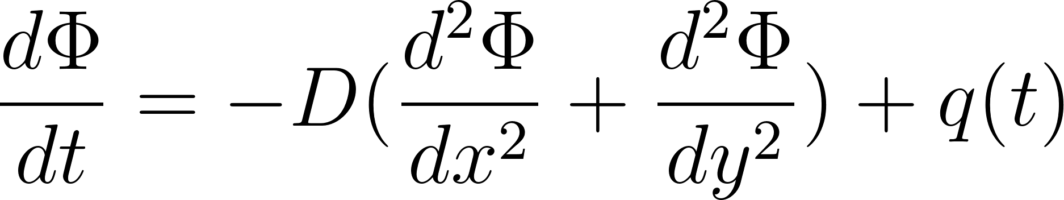
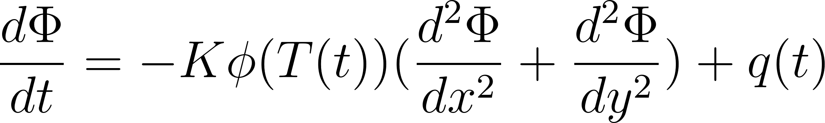
What is the relationship between increasing temperature and fluid concentration of a parcel of soil?
2D system is considered
Fluid diffusion model is created using a parabolic partial differential equation
Multigrid Jacobi method is used for numerical computation
Fick’s original diffusion equation
Our modified diffusion equation, which depends on temperature, thermal expansion, and soil properties. Diffusion changes over time.

Slide 3
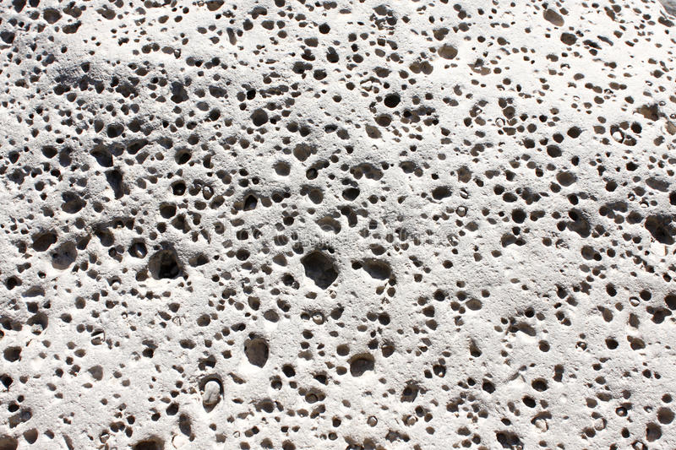
Conceptual Principles
Impermeable boundary
The fluid moves via a forcing term from one side of the world.
The fluid can start in three different configurations: (1) center point, (2) edge point, and (3) along the entire edge.
The parcel is set in a box so that the boundaries are impermeable.
FLUID
“Sandbox” through which fluid percolates

Slide 4
The Multigrid
Approach
Initial guess
Smoothing #1
Three Jacobi Iterations
A recursive 6-layer multigrid is used
This saves computation time as the algorithm converges faster
The coarsest grid is 2x2
Smoothing #2
Error computation
Three Jacobi Iterations
Calculate the residuals after the first set of Jacobi iterations
Correction
Restriction
Add prolonged coarser grid solution onto the finer grid.
Downsample residuals to the next coarsest grid
Prolongation
Interpolate a correction computed on a coaster grid into a finer grid

Slide 5
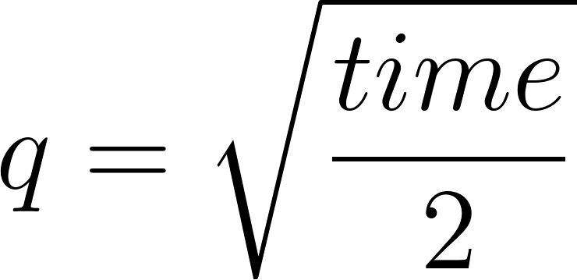
Results for Different Fluid Sources
Fluid input varies with time
Fluid influx is “turned off” at t = 80

